Slide 1

Computer Graphics
Presented by-
43. Savant Omkar
1. Wani Pushpak
45. Raut Atharva

Slide 2

Computer Graphics
Computer Graphics is the creation of pictures with the help of a computer..
In today life, computer graphics has now become a common element in user interfaces

Slide 3
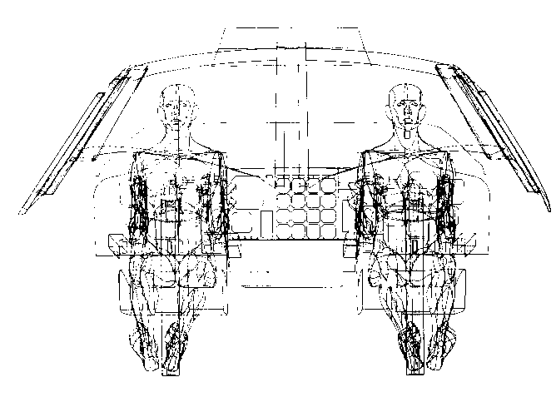
History
Computer Graphics (CG) was first developed as a visualization tool.
Computer graphics were basically introduced for scientists and engineers at Bell Labs and Boeing in the 1950s.
William Fetter invented term Computer Graphics in 1950s.

Slide 4
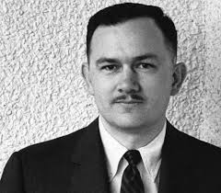
William Fetter
He invented Computer Graphics in 1950s.
He was the first one to create a human figure in 3D, in 1960.

Slide 5
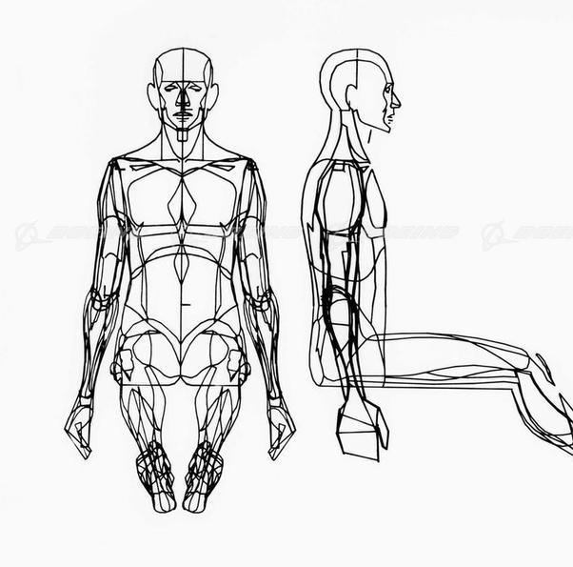
First ever 3D Human Model

Slide 6

Loops in C
Looping is one of the key concepts on any programming language.
It executes a block of statements number of times until the condition becomes false.
Loops are of 2 types: entry-controlled and exit-controlled.

Slide 7

What have we Designed?
We have designed a moving car animation in Computer Graphics.
It was created with adequate use of various function in Graphics as well as with help of loop.

Slide 8
How did you created it?
We used for loop and a bunch of line and circle function to design the moving car.
The logic is that, everytime a single function executes and then after it’s done it is incremented by 1 pixel.
This is done until the for condition is fulfilled.
After loop completes we can see the car moving on the output screen.

Slide 9

Algorithm
Start
Declare variable i,j
Intialise graphics driver and graphics mode.
Check for condition.
If condition is true then go to step 6, otherwise go to step 8.
Execute the code and increment i.
Go to step 4.
Stop.

Slide 10
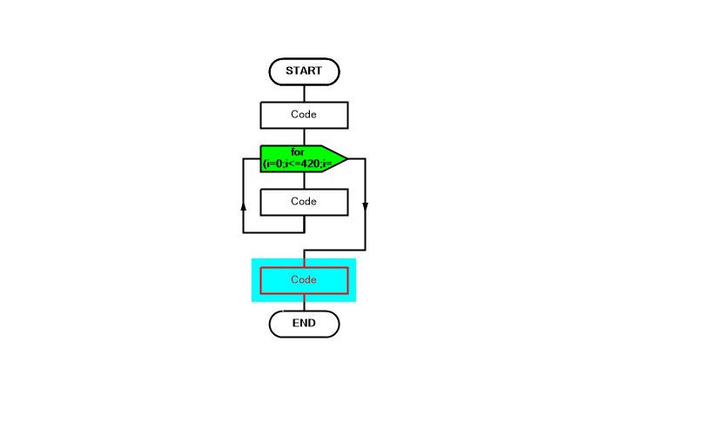
Flowchart

Slide 11
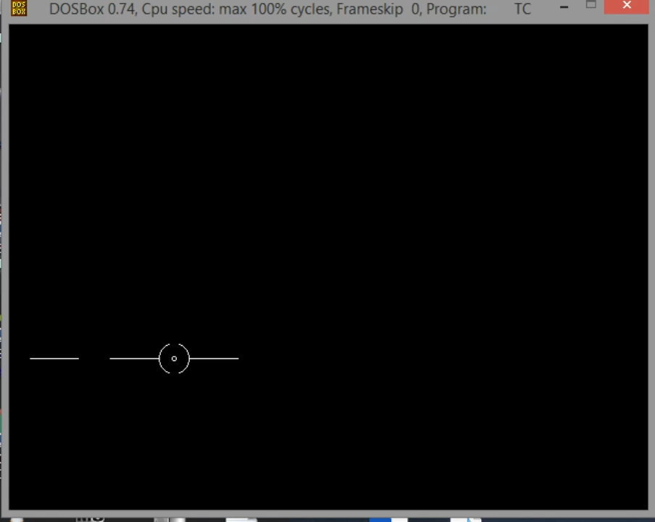
Output

Slide 12

Advantages
Flexibility.
Graphical representation software contributes much in research.
Advertising.

Slide 13

Disadvantage
Complexity.
Limitations.

Slide 14
Conclusion
It is difficult to display an image of any size on the computer screen. This method is simplified by using Computer graphics.
Graphics on the computer are produced by using various algorithms and techniques.
Computer Graphics is the creation of pictures with the help of a computer.

Slide 15


